Slide 1
Effects of Temperature in Chicago
By: Chamil De Zoysa, Mark Green, Ed Wise and Stephanie Armenta

Slide 2
Summary & Motivation
Core Message:
Having a deeper understanding of the city we live/ go to school in
Summary:
How outside temperature affects Transportation and Public Safety in Chicago
Motivation:
Making travel decisions work in our favor depending on outside temperature
Trying to uncover patterns behind Chicago’s violent reputation; being more self-aware to protect ourselves
Sources:
Chicago Data Portal
Taxi trips: reported trips to the City of Chicago in its role as a regulatory agency for 2016-2017
Crimes: reported incidents of crime that occurred in the City of Chicago in 2011-2016; filtered to robberies and assaults only
Divvy Data
Daily Ride Count: reported ride counts in entire city of Chicago for 2016-2017
NOAA Global Surface Summary of the Day Weather Data
Temperature: using online data files from 2011-2017

Slide 3
Data Exploration & Cleanup
Technologies:
Google Clould API – to query BigQuery data sets
MySQL – to organize divvy data files (35 million records)
Jupyter Notebooks

Slide 4
Taxi Trips vs Temperature
Questions & Motivation:
Is there any relationship between outside temperature and daily taxi trip?
Avoiding taxis during peak seasons; saving time by avoiding heavy traffic
Notably more taxi rides in Fall season vs. Spring season
If there is a correlation, will this also be the same for other forms of transportation?
Comparing different taxi and Divvy Bike datasets vs static variable, temperature, to figure out fastest route; we’re all about efficiency: time is money!

Slide 5
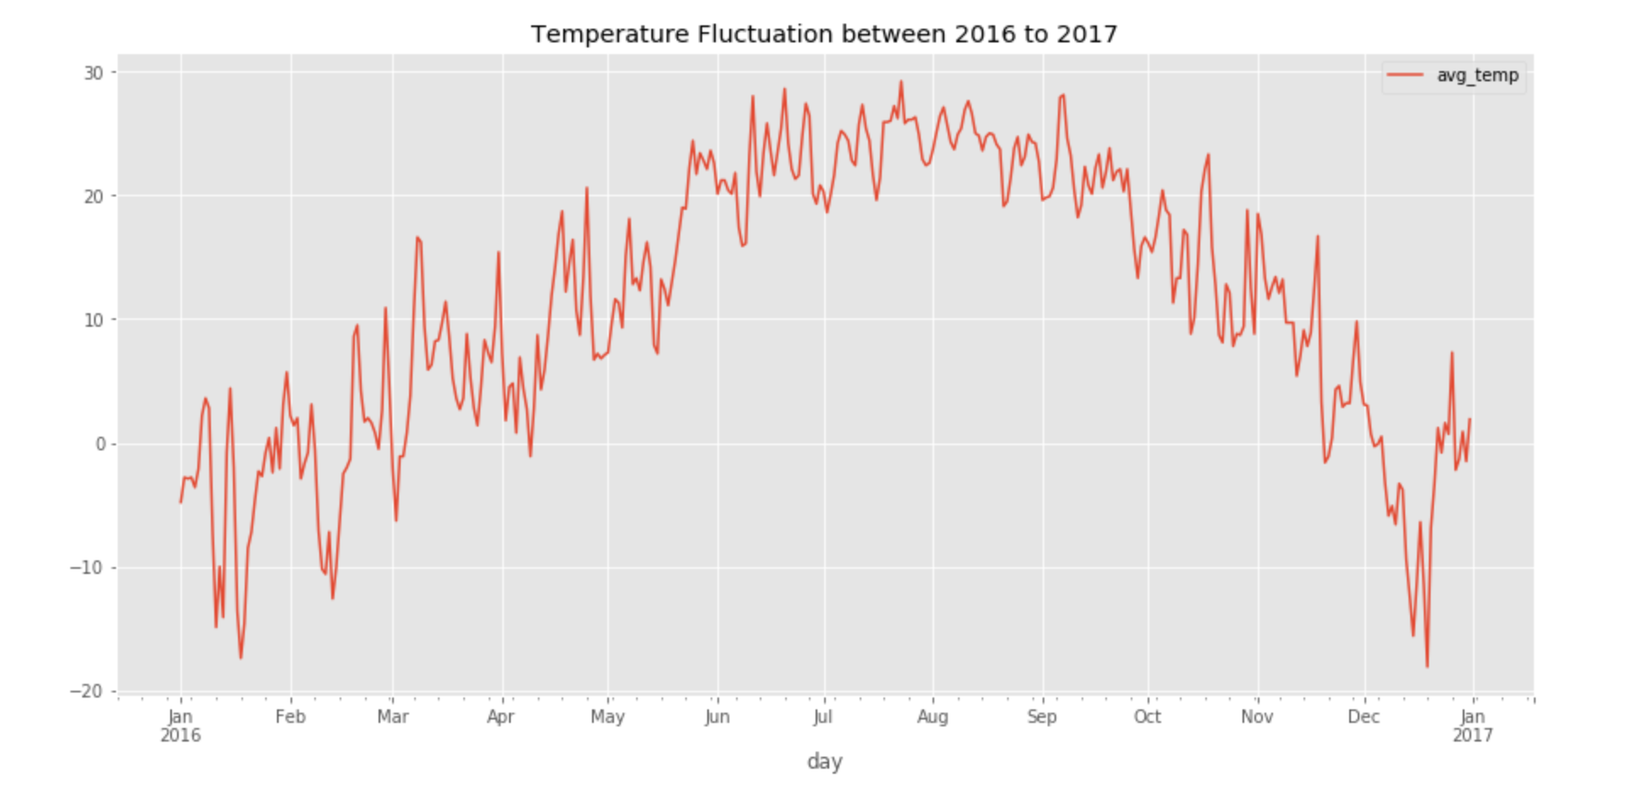
Taxi Trips vs Average Temperature

Slide 6
Daily Ride Divvy Counts vs Temperature
Questions & Motivation:
What is the average temperature people in Chicago start to ride more Divvy Bikes?
Useful if planning a ride Divvy based on outside temperature
Divvy use spikes when 60+ degrees out; Peak temp is 75
Popularity has vastly increased from 2016 to 2017
Do people still ride Bikes in freezing temperatures?
Just curious to know! Chicago winters won’t slow down everyone
Yes, but less than 5000 total riders until temperature climbs over 20 degrees

Slide 7
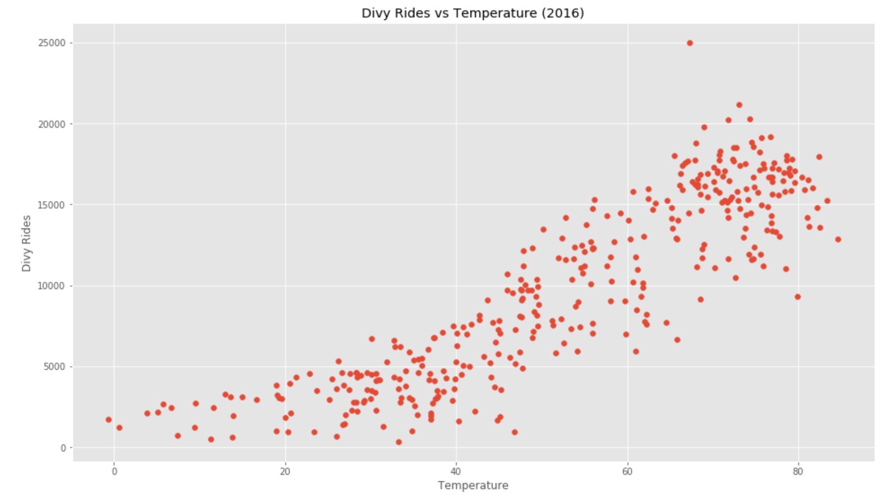
Divvy Rides vs Temperature

Slide 8
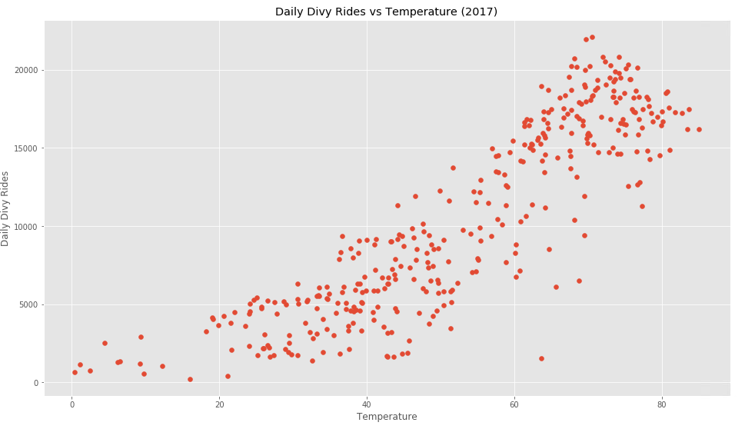
Divvy Rides vs Temperature

Slide 9
Crime Data vs Temperature
Questions & Motivation:
What is the average temperature that most crime occurs in Chicago?
Being more self-aware in public places depending on temperature outside
75 degrees is the peak for crime rate
Are there any crime spikes during colder temperatures? If so, what temperature?
Trying to confirm if crime is limited to only warmer weather
15 – 25 degrees sees crime jump incidents jump to 250+ unexpectedly

Slide 10
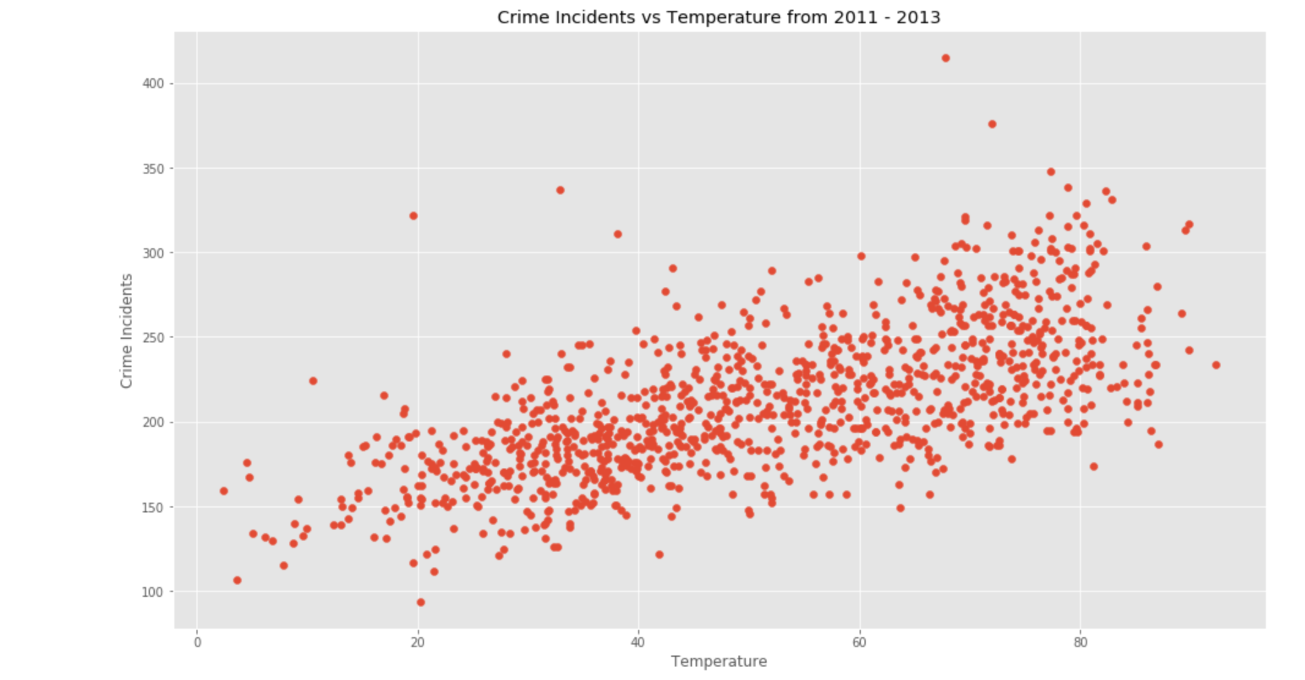
Crime Data vs Temperature

Slide 11
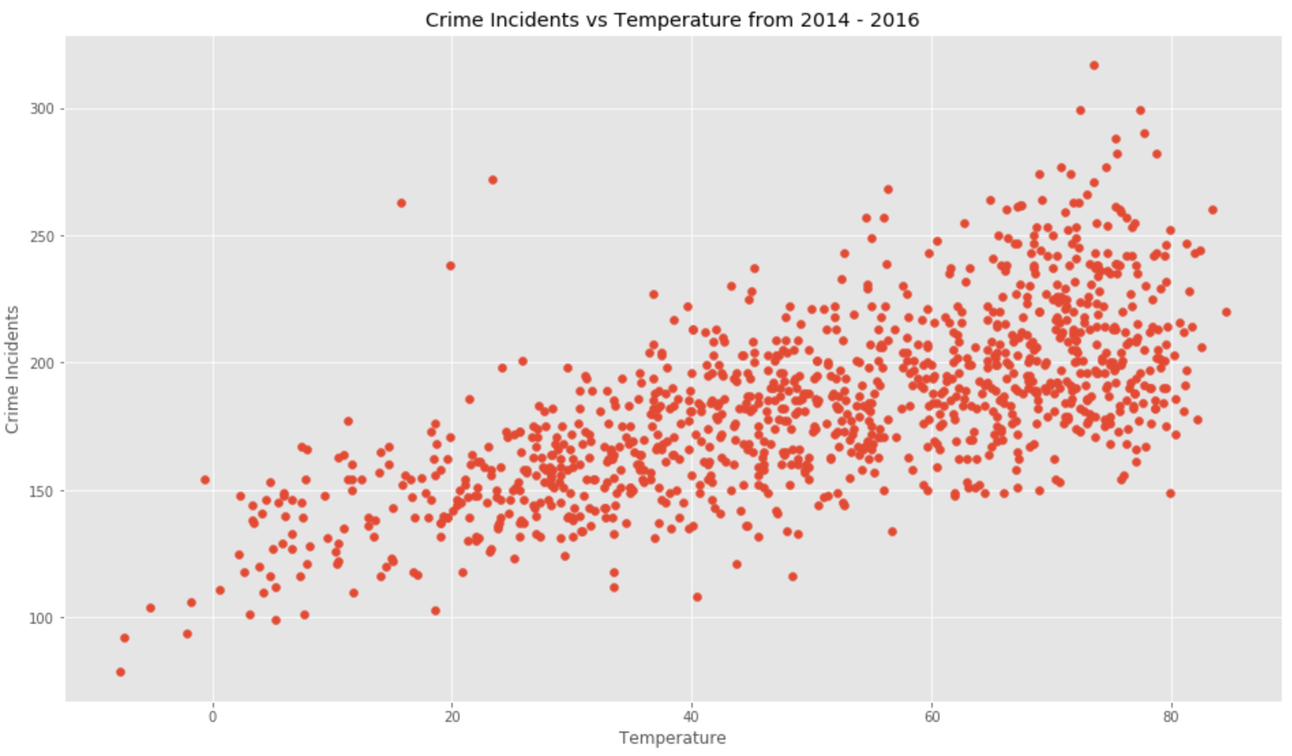
Crime Data vs Temperature

Slide 12
Data Analysis
Implications of our findings:
No clear correlation between temperature and taxi rides
As temperature increased, number of Divvy daily ride count increased; people prefer to ride Divvys when it’s warmer outside
As temperature increased in Chicago, number of crimes increased; more people are outside; criminals are active/ more willing to break the law

Slide 13
Takeaways
Warmer weather in Chicago has the potential to encourage an active lifestyle. Unfortunately, it also promotes criminal activity.
We live in a beautiful city and should take advantage of warm weather but at the same time being extra cautious when we are outside.
It is important to remember what transportation resources our city provides throughout our various seasons and to avoid being a victim of unnecessary crime.

